Slide 1

Home Loan Data Science Project
Task3
Date:-08 March,2023
Vaibhav Amrutkar

Slide 2
Agenda:
Data Science Lifecycle
Project Overview
Data
Analysis
Modeling
Model Evaluation
Recommendation

Slide 3
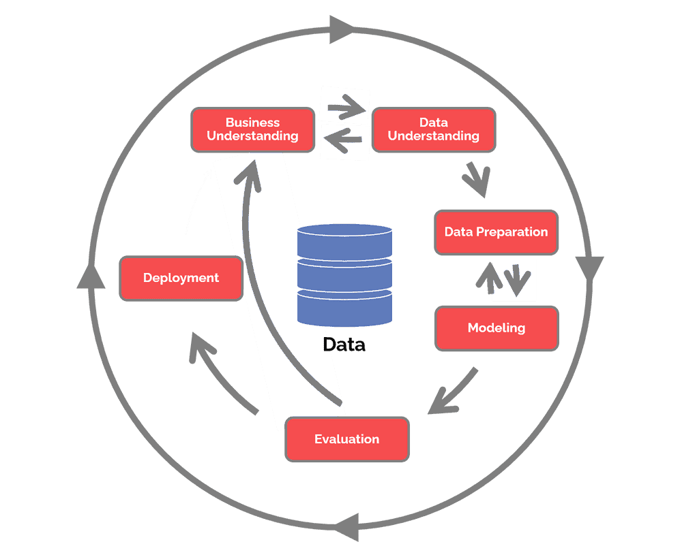
Data Science
L
I
F
E
C
Y
C
L
E

Slide 4
Project Overview
♦ Business Problem:
At the moment, applying for a home loan is a laborious procedure. It takes 2 to 3 days, so the applicant won't learn the results of their application until after those 2 to 3 days.
♦ Business Objective:
Help the user by getting information regarding the status of their loans in a matter of seconds.
♦ Hypothesis:
Machine learning may be used to forecast a future borrower's loan status based on historical data, greatly reducing the time it takes for them to discover their separate statuses.

Slide 5


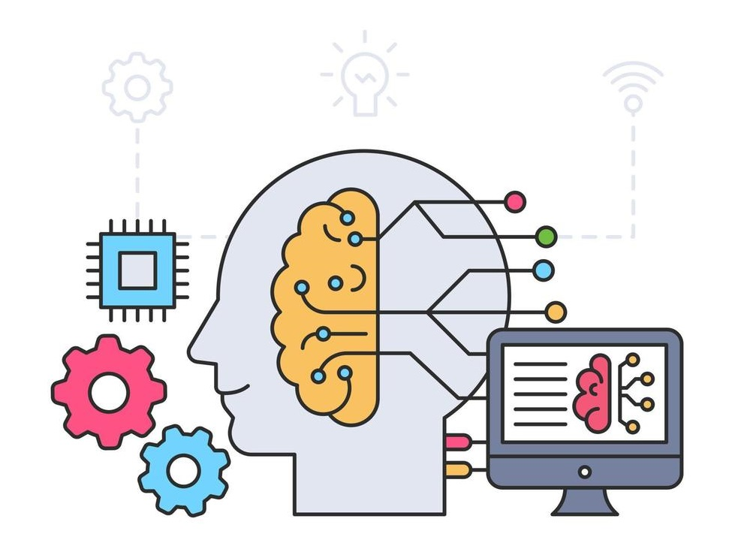

TEXT LAYOUT 1
Process Overview / Solution

Slide 6
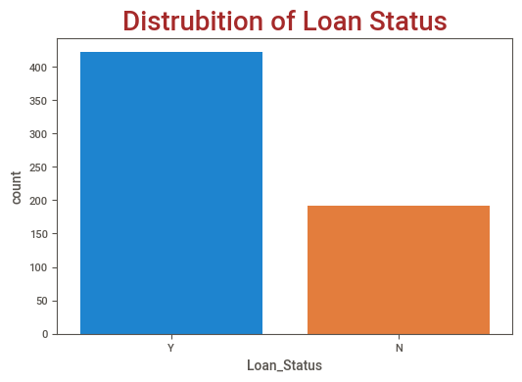
TEXT LAYOUT 1
Data (Historical Data)
♦ Train Data contains 614 Rows and total 13 columns
♦ Out of 13 columns there are 5 numerical columns
(4 float, 1 integer) and 8 object columns
♦ Target variable – Loan Status Y(422) and N (192)

Slide 7
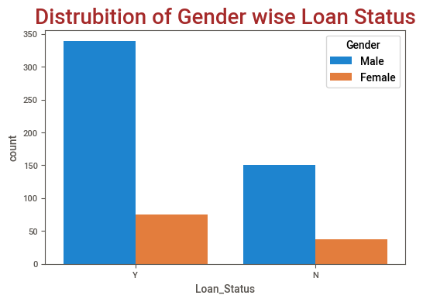
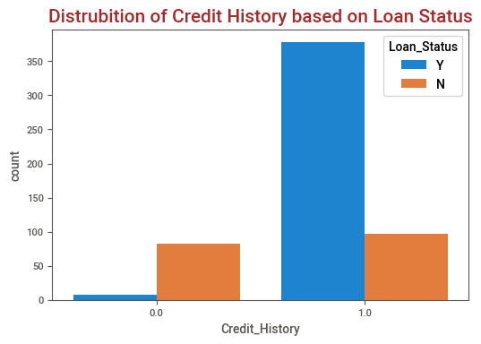
TEXT LAYOUT 1
Analysis
Men have a higher loan status of Yes than women do, and same goes to loan status of No.
candidates with credit histories may be more likely to default than those without them.

Slide 8
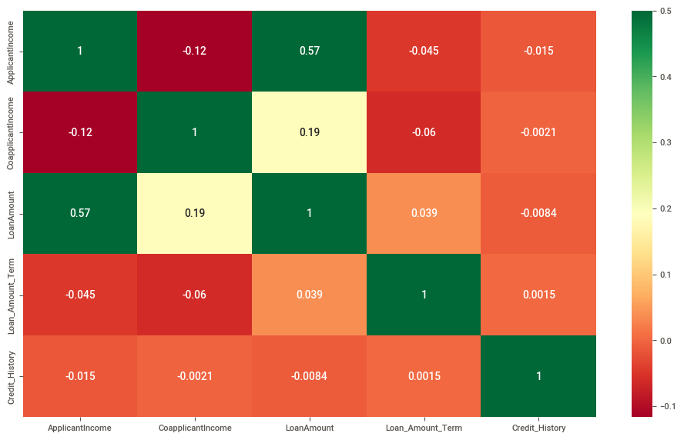
Analysis
There is a correlation between the applicant's income and the loan amount they applied for.

Slide 9
Modeling
• The RandomForestClassifier machine learning model is one that has been trained.
• Along with traditional machine learning models, AutoML is also applied.
• Custom-made machine learning model required pre-processing
• AutoML did not required pre-processing
• Results from AutoML and conventional machine learning models are equivalent.

Slide 10
Model Evaluation
 | AutoML | Custom-made ML
Accuracy | 78% | 77%
• Where accuracy is the total of all the model's correctly predicted outcomes over all predicted outcomes.

Slide 11
Recommendations
• Custom-made ML is better than AutoML
• We are fully aware of what was used, how it was used, and what algorithm was applied to accomplish the goal.
• If we can train and forecast in real time, it will benefit us and take less time to do so, although this use case may not allow for it.
• The ideal application for AutoML is as a foundational model.

